Slide 1



Training Module:
Conrad N. Hilton Foundation Substance Use Prevention Initiative
in partnership with
University of California, Los Angeles Integrated Substance Abuse Programs
Substance Use, Adolescent Health, and SBIRT in Juvenile Justice
Notes:
TRAINER NOTES: The purpose of this training module is to provide trainees with knowledge about the health impact of substance use, with a focus on how substance use impacts adolescents and why substance use prevention and early intervention for adolescents is critical for public health. This module was created by researchers from UCLA’s Integrated Substance Abuse Programs’ Training Center, with generous support from the Conrad N. Hilton Foundation. These materials were created for use by Conrad N. Hilton grantees as they plan and implement their substance use prevention and early intervention programs for adolescents.

Slide 2
Training Objectives
By the end of this training, participants will be able to:
Describe three ways that substance use can impact the short term health and well-being of adolescents.
Explain substance use disorders and their causes
Understand why it is particularly critical to address substance use among adolescents
Describe two ways other than risk for substance use disorders that substance use puts the long-term health and well-being of adolescents at risk
Describe the SBIRT model
Notes:
TRAINER NOTES: Read the four main training objectives described on the slide.

Slide 3
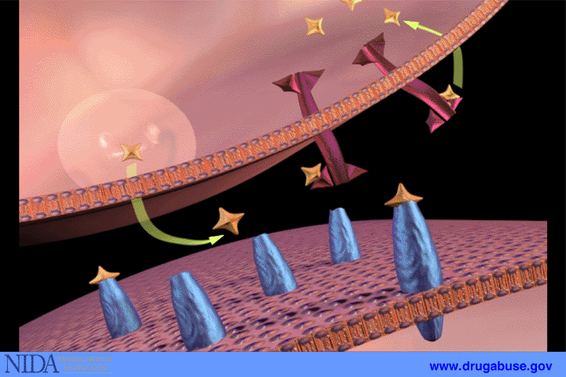
What Psychoactive Substances Do: Trigger Dopamine
Dopamine is the neurotransmitter released when we do things essential for survival (eat, drink, sex)
  Pleasure/Well-being
  Satiation
  Sedation
Psychoactive drugs’ chemical structures stimulate release of dopamine in different parts of the brain
Notes:
TRAINER NOTES: Read the slide, highlighting that dopamine is the neurotransmitter released when we do things we need to do for survival.
More information about dopamine:
Most drugs of abuse directly or indirectly target the brain’s reward system by flooding the circuit with dopamine. Dopamine is a neurotransmitter present in regions of the brain that regulate movement, emotion, motivation, and feelings of pleasure. When activated at normal levels, this system rewards our natural behaviors. Overstimulating the system with drugs, however, produces euphoric effects, which strongly reinforce the behavior of drug use—teaching the user to repeat it.
Source: NIDA, Drugs, Brains, and Behavior: https://www.drugabuse.gov/publications/drugs-brains-behavior-science-addiction/drugs-brain
IMAGE SOURCE: https://www.drugabuse.gov/publications/teaching-packets/understanding-drug-abuse-addiction/section-i/7-neurotransmission-continued

Slide 4
Natural Rewards and Dopamine
FOOD
SEX
200
200
NAc shell
150
150
DA Concentration (% Baseline)
100
100
15
% of Basal DA Output
Empty
10
50
Copulation Frequency
Box
Feeding
5
0
0
0
60
120
180
Scr
Scr
Scr
Scr
Time (min)
Bas
Female 1 Present
Female 2 Present
Sample
Number
1
2
3
4
5
6
7
8
9
10
11
12
13
14
15
16
17
Mounts
Intromissions
Ejaculations
Di Chiara 2007
Fiorino 1999
Notes:
TRAINER NOTES: Explain that natural rewards stimulate dopamine neurotransmission. Eating something that you enjoy or being stimulated sexually can cause dopamine levels to increase. In these graphs, dopamine is being measured inside the brains of animals. Its increase is shown in response to food or sex cues. This basic mechanism of controlled dopamine release and reuptake has been carefully shaped and calibrated by evolution to reward normal activities critical for our survival.

Slide 5
Effects of Substances on Dopamine Release
1500
1000
500
0
METHAMPHETAMINE
COCAINE
400
Accumbens
Accumbens
300
DA
DOPAC
% of Basal Release
HVA
% Basal Release
200
100
0
1
2
3hr
0
Time After Methamphetamine
Time After Cocaine
250
Accumbens
NICOTINE
250
Accumbens
ETHANOL
200
Accumbens
200
Dose (g/kg ip)
Caudate
0.25
150
% of Basal Release
0.5
% of Basal Release
1
150
2.5
100
100
0
0
1
2
3 hr
0
Time After Nicotine
0
1
2
3
4hr
Time After Ethanol
Shoblock 2003; Di Chiara 1987
Notes:
TRAINER NOTES: This slide has animations, so practice before presenting. Explain that:
Nearly all drugs of abuse increase dopamine neurotransmission, either directly or indirectly. This slide shows the increase in brain dopamine (DA) levels (measured in animals) following exposure to various drugs of abuse. All of the drugs depicted in this slide have different mechanisms of action, however they all increase activity in the brain reward pathway by increasing dopamine neurotransmission. It is because drugs activate these brain regions⎯usually more effectively and for longer periods of time than natural rewards⎯that they have an inherent risk of being abused.
As you click through, the slide will illustrate the increased levels of dopamine associated with ethanol (alcohol) use, nicotine, cocaine, and methamphetamines. Highlight that alcohol and nicotine are as strong or stronger than natural rewards for food and sex, while other substances like cocaine and methamphetamines cause 2-8 times the amount of dopamine release than our bodies would naturally produce.

Slide 6
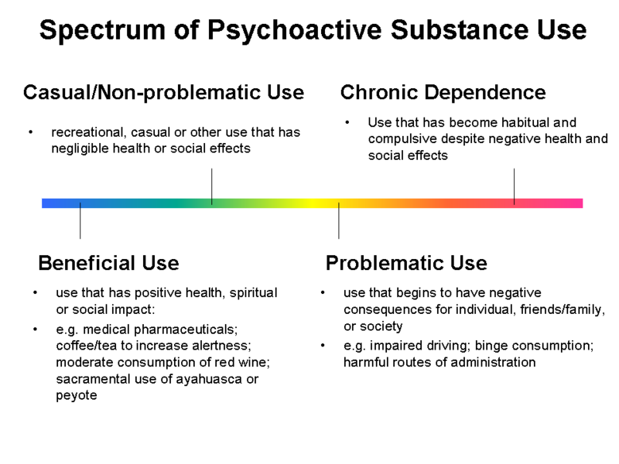
Notes:
TRAINER NOTES: This slide shows that there is a spectrum of psychoactive substance use, and not all of it is problematic. As you review the slide, highlight these points:
Most people who use psychoactive substances fall on the left side of the spectrum—casual/non-problematic or beneficial use, for the reasons descried on the slide.
However, a sizeable number develop problematic use (as defined on the slide) or chronic dependence (as described on the slide)

Slide 7
When Substance Use Becomes Problematic
Negative impacts of substance use begin to outweigh the benefits
  Substance effects that are unpleasant or harmful
  Consequences of things done while intoxicated
  Impact on individual, friends/family, or society
  Health impacts
    Overdose
    Substance use disorders
    Impact on mental health
    Impact on physical health
Notes:
TRAINER NOTES: Review the information on the slide, highlighting that you will be reviewing each of these points in detail on the following slides.
More information on drugs and the brain can be found at the National Institute on Drug Abuse website:
https://www.drugabuse.gov/publications/drugs-brains-behavior-science-addiction/drugs-brain

Slide 8
The Problematic Aspects of Getting Drunk/High
 | Alcohol | Cannabis | Opioids | Stimulants | Sedatives | Inhalants
Mood Swings |  | X |  | X |  | X
Impaired Body Movement | X | X | X |  | X | X
Impaired Cognition, Problem Solving, Judgment | X | X | X |  | X | X
Memory Problems |  | X | X |  | X | X
Drowsiness | X | X | X |  | X
Anxiety/ Confusion |  | X | X | X
Paranoia/Panic |  | X |  | X
Aggression/ Violence | X |  |  | X |  | X
Psychosis/ Hallucinations |  | X | X | X |  | X
Notes:
TRAINER NOTES: The purpose of this slide is to highlight some of the acute effects of intoxication that may be negative or unpleasant. Highlight that even for people who never develop substance use disorders, these are potential consequences of getting drunk or high that could be problematic, both for people who use alcohol/drugs and those around them.

Slide 9
The Problematic Aspects: Bad Decisions
Sexual Risk
  Substance use increases risky sex behavior and chances of contracting HIV among MSM (Boone 2013; Chesney 1998)
  Binge drinking associated with unintended pregnancy (Naimi 2003)
Injury Risk
  Alcohol is involved in 60% of fatal falls and over 60% of fire deaths (D’Onofrio 2008)
  Alcohol consumption increases risk of violence-related injury (Cherpitel 2007)
Almost 8% of ED visits in US are attributable to alcohol (McDonald 2004)
35-40% of ED patients have illicit drugs in their system (Vitale 2006)
Notes:
TRAINER NOTES: Review the information on the slide, highlighting that one of the major drawbacks of substance use is that people make bad decisions when they are under the influence of alcohol/drugs, largely due to reduced inhibitions. In particular, people have increased risk for risky sexual behavior (contracting sexually transmitted infections, unwanted pregnancy) or injury when under the influence of alcohol or drugs.

Slide 10

The Problematic Aspects:
Bad Decisions
Impaired Driving
  Blood Alcohol Content (BAC) of .08: Four times risk of a crash
  BAC of .15: 12 times risk of a crash
  Insufficient numbers to draw conclusions for other substances, but we know they impact reaction time and decision making
Crime
  26% of victims of violence report attacker seemed like they were under the influence of alcohol/drugs
  Over half of jail inmates charged with robbery, burglary, motor vehicle theft report using drugs at time of offense
  46-49% of probationers say they used alcohol/drugs at time of offense
National Highway Traffic Safety Administration, ND; Bureau of Justice Statistics ND; Smith 2012
Notes:
TRAINER NOTES: Review the information on the slide, highlighting that:
High blood alcohol levels significantly increases chances of crashes when driving.
We don’t yet sufficient data for drugs and driving because drug use is not as common and it is difficult to correlate BAC and intoxication with some of the most commonly used psychoactive drugs. However, there is evidence that drug use is associated with negative impacts on reaction time and decision making, which are associated with risk for motor vehicle accidents.
There is also significant evidence—both from victim reports and surveys with criminal offenders—that substance use is often associated with the commission of crime, as described on the slide. A major reason for this is likely that alcohol/drugs lower inhibitions that would normally hold people back from engaging in criminal behavior.
IMAGE SOURCE: https://www.drugabuse.gov/news-events/latest-science/depressive-symptoms-drug-abuse-in-adolescents
http://www.bjs.gov/content/dcf/duc.cfm#to

Slide 11

The Problematic Aspects:
Overdose
Alcohol
  Poisoning occurs when alcohol shuts down areas of the brain that control basic life-support functions (breathing, heart rate)
  Can cause brain damage and death
Stimulants
  Impact heart and blood vessels, leading to heart attacks, strokes, seizures
Opioids
  Act on part of the brain that regulates breathing
  Can cause respiratory depression and death
  Increased risk when combined with alcohol or sedatives
Notes:
TRAINER NOTES: Review the information on the slide, highlighting that overdose is a serious risk, even for people who do not meet diagnostic criteria for substance use disorders.
More information on the effects of substances on the body can be found at the National Institute on Drug Abuse website:
https://www.drugabuse.gov/publications/drugs-brains-behavior-science-addiction/preface
IMAGE SOURCE: http://pubs.niaaa.nih.gov/publications/AlcoholOverdoseFactsheet/Overdosefact.htm
http://www.cdc.gov/media/dpk/2015/dpk-vs-alcohol-poisoning.html

Slide 12
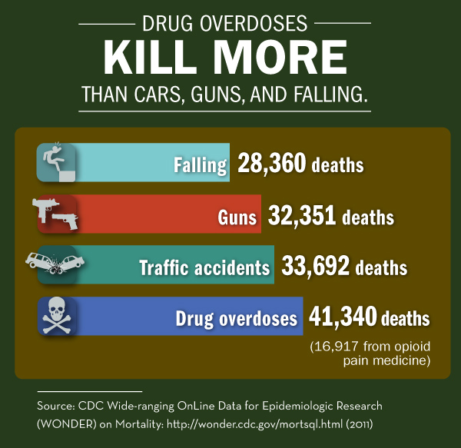
Notes:
TRAINER NOTES: This slide highlights that drug overdoses—a large portion of them attributed to opioids (both medications and heroin)—now account for more deaths in the United States each year than falls, guns, and traffic accidents.
Citation:
The National Institute on Drug Abuse Blog Team. (2014, September 18). Drug Overdoses Kill More Than Cars, Guns, and Falling—UPDATE . Retrieved from https://teens.drugabuse.gov/blog/post/drug-overdoses-kill-more-cars-guns-and-falling-update on October 25, 2017.
https://teens.drugabuse.gov/blog/post/drug-overdoses-kill-more-cars-guns-and-falling-update

Slide 13

The Not Fun Aspects :
Substance Use Disorders (SUD)
SUD are medical conditions, not a matter of choice or will
There is no biological test, but recognized through behavior
  Compulsive substance use
  Loss of control over substance use
Notes:
TRAINER NOTES: The next 14 slides provide information about substance use disorders.
On this slide, highlight that:
The preferred term for these conditions is “substance use disorders,” since the term “addiction” carries negative social stigma and may not accurately describe the disorder.
Highlight that substance use disorders are defined and diagnosed through behaviors—particularly compulsive substance use and loss of control over substance use.

Slide 14
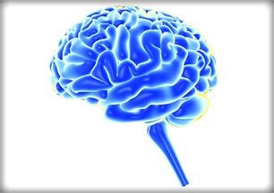
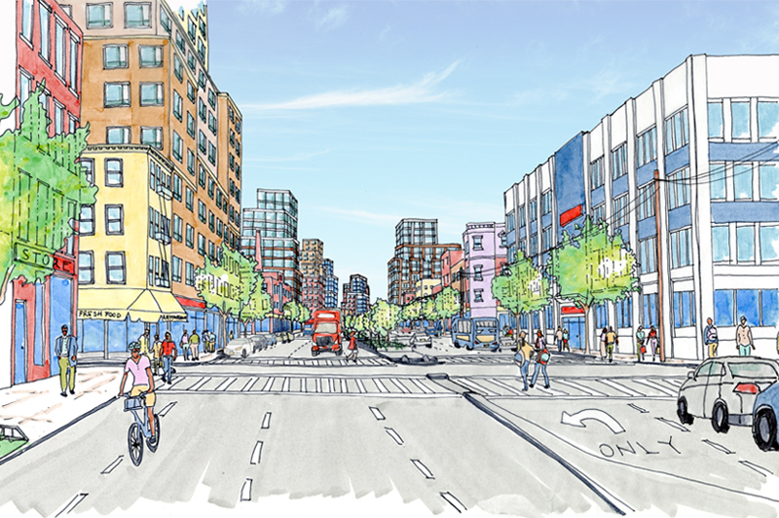
Substance Use Disorders
SUDs are brain diseases
  Changes in brain structure and function
  40-60% of SUD vulnerability is genetic (alcohol, tobacco)
Environmental factors also play a key role
  Exposure to substances
  Culture/norms
  Relationships (family, friends, school, work)
  Stress and trauma
NIDA 2010
Notes:
More information regarding SUDs as a brain disease can be found in the Lancet Article, “Brain disease model of addiction: Why is it so controversial?”:
http://www.sciencedirect.com/science/article/pii/S2215036615002369
Citation:
Volkow, Koob Lancet Psychiatry. 2015 Aug;2(8):677-679. doi: 10.1016/S2215-0366(15)00236-9.
Volume 2, Issue 8, August 2015, Pages 677-679
IMAGES: Brain https://teens.drugabuse.gov/drug-facts/brain-and-addiction
Neighborhood http://www1.nyc.gov/site/planning/plans/east-new-york/east-new-york-1.page

Slide 15
Substance Use Disorders
American Psychiatric Association’s Diagnostic and Statistical Manual of Mental Disorders, 5th Edition (2013)
  Describes 11 diagnostic criteria for SUD
  Mild SUD: 2-3 criteria
  Moderate SUD: 4-5 criteria
  Severe SUD: 6 or more criteria
  Criteria include impulse control, social impairment, risky use, tolerance/withdrawal

Slide 16
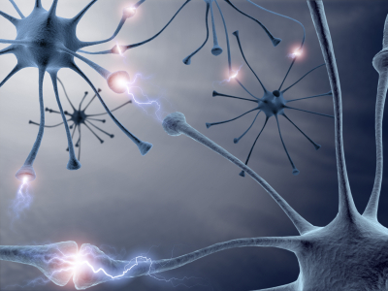
Prolonged Drug Use Changes
The Brain In Fundamental and
Long-Lasting Ways
Notes:
TRAINER NOTES: This slide and the next slide include animations, so practice them before presenting. They help introduce and frame the slides that follow.

Slide 17
AND…
We Have Evidence That
These Changes Can Be Both
Functional and Structural

Slide 18


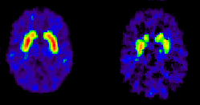
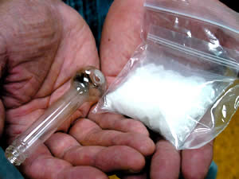
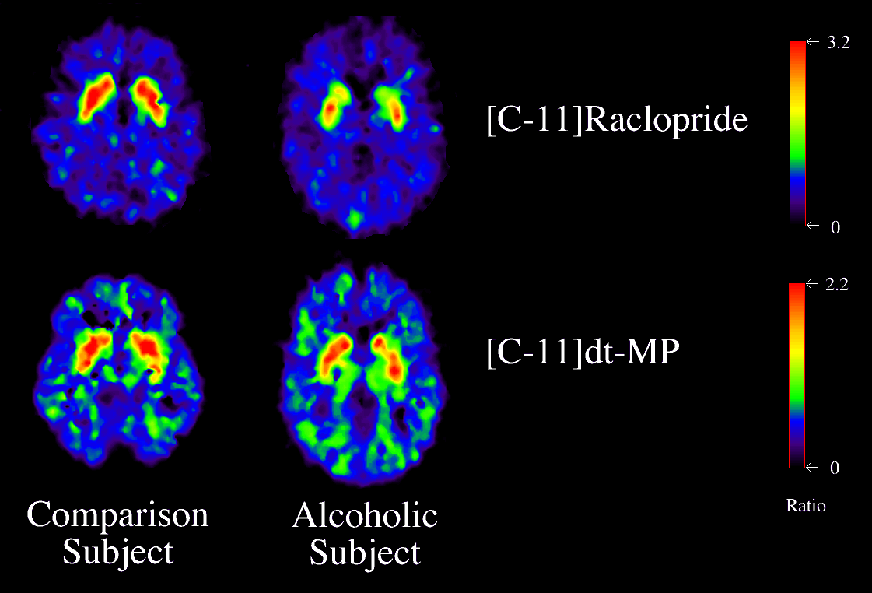
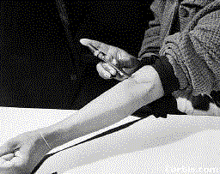
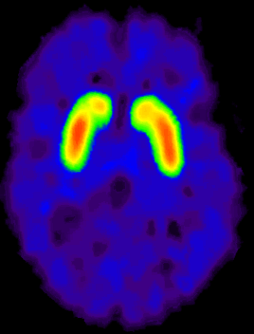
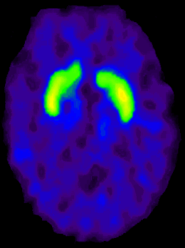
Dopamine D2 Receptors are Lower in Addiction
DA
Cocaine
DA
DA
DA
DA
DA
DA
DA
DA
DA
DA
DA
Meth
Reward Circuits
Non-Drug Abuser
DA D2 Receptor Availability
Alcohol
DA
DA
DA
DA
DA
DA
Heroin
Reward Circuits
control
addicted
Drug Abuser
Notes:
TRAINER NOTES: Repeated drug exposure also changes brain function. Positron emission tomography (PET) images show similar changes in brain dopamine receptors resulting from addiction to different substances. Dopamine D2 receptors are one of five types of receptors that bind dopamine in the brain. The brain images on the left are those of controls, while those on the right are from individuals addicted to cocaine, methamphetamine, alcohol, or heroin. The striatum (which contains the reward and motor circuitry) shows up as bright red and yellow in the controls (in the left column), indicating numerous D2 receptors. Conversely, the brains of addicted individuals (in the right column) show a less intense signal, indicating lower levels of D2 receptors. This reduction likely stems from repeated over-stimulation of the dopamine receptors. Brain adaptations such as this contribute to the compulsion to abuse drugs.

Slide 19
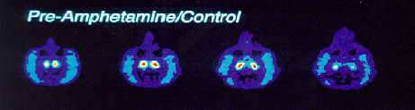

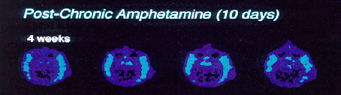
PET Scan of Long-Term Impact of
Methamphetamine on the Brain
Notes:
TRAINER NOTES: Brain imaging researchers were interested in seeing what would happen if previously unexposed brains were exposed to methamphetamine. In the top set of Positron Emission Tomography (PET) scans (which are cross section slices taken from the top of the monkey’s eyes to the bottom of the monkey’s eyes) illustrates what a monkey’s brain that has never been exposed to methamphetamine looks like. What you’ll notice is that there is a lot of bright red/orange color in the egg-shaped areas in the center of the scan. This indicates that there is a lot of activity occurring in the monkey’s reward center.
The monkeys were then exposed to 10 days of what would be considered to be a high human dose of methamphetamine, and rescanned 4 weeks after the last dose of meth. What do you see in the second set of scans? Essentially, you see virtually no dopamine activity in the reward centers of the monkey’s brain, suggesting very severe disruption of the dopamine neurons.
If you were to apply human emotions to the monkey, how would the monkey be feeling? The monkey would be feeling depressed, sad, distraught, etc.
You’ll see in a few slides what happens to the monkey’s brain over time.

Slide 20
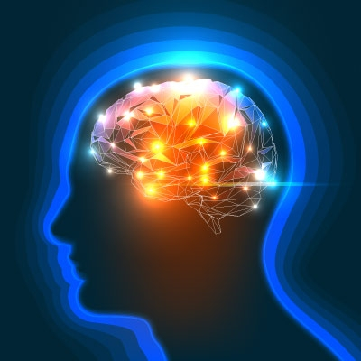
How Brain Changes Link To Behavior
Neurochemical changes impact the dopamine reward pathway—the wiring that makes us naturally want what we need (e.g. food, water)
Brain changes from prolonged use makes us instinctually crave substances as if we need them to survive
Notes:
TRAINER NOTES: Read and emphasize the points on the slide
Biblical proverb: People do not despise a thief if he steals to satisfy his hunger when he is starving—the need for drugs become just as pressing as the need for food.
https://teens.drugabuse.gov/blog/post/traumatic-brain-injury-drug-addiction-and-developing-teen-brain

Slide 21
Beyond Craving
Prolonged substance use leads to brain changes that impair cognition and memory
  Most developed evidence is from stimulants (was of interest when scanning technology developed)
  Knowledge of other substances is developing
Notes:
TRAINER NOTES: Read the slide, which provides context for the following four slides.

Slide 22
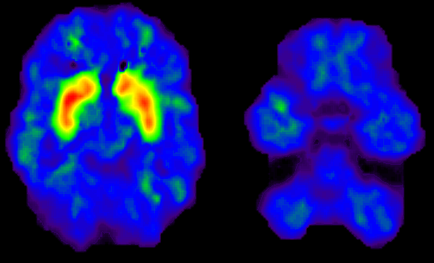
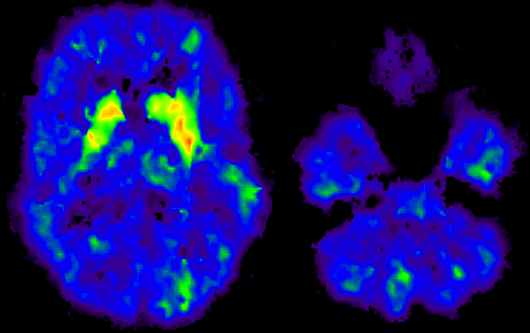
Dopamine Transporters in
Methamphetamine Abusers
Motor Activity
2.0
1.8
(Bmax/Kd)
1.6
Dopamine Transporter
1.4
1.2
Normal Control
1.0
7
8
9
10
11
12
13
Time Gait
(seconds)
2
Memory
1.8
1.6
Dopamine Transporter
Bmax/Kd
1.4
1.2
Methamphetamine Abuser
1
16
14
12
10
8
6
4
Volkow 2001.
p < 0.0002
Delayed Recall
(words remembered)
Notes:
TRAINER NOTES: Methamphetamine abuse decreases dopamine transporter activity and compromises mental function. The brain image at the top left is a PET image from a normal control subject. The striatum is brightly lit in red and yellow, indicating the presence of many dopamine transporters, which contrasts with the brain of a methamphetamine abuser (bottom left). What does this mean functionally? The graphs on the right show the relationship between performance on a motor (upper right) and a memory task (lower right) and methamphetamine-driven decreases in dopamine transporters. The magnitude of the decline in the dopamine transporter binding is positively correlated with the extent of motor and memory impairment; thus the greater the decline, the greater the impairment in memory and motor reaction time.

Slide 23
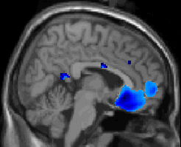
Control
> MA
4
3
2
1
0
Notes:
TRAINER NOTES: The limbic system lies between the brain stem and the cerebral cortex. It is involved with learning, motivation, memory, and emotion. Methamphetamine does much of its work in two key structures in the limbic system: the amygdala and the hippocampus.
In this comparative scan of a control and methamphetamine abuser, you see a deactivation in the prefrontal cortex of the meth abuser, the part of the brain responsible for high-order decision making. This means that methamphetamine abusers are less able to make higher-order decisions (like stopping their drug use).

Slide 24
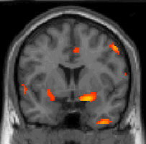
MA >
Control
5
4
3
2
1
0
Notes:
TRAINER NOTES: In this comparative scan of a control and methamphetamine abuser, you see a hyper-activation in the amygdala of the methamphetamine abuser, the part of the brain responsible for emotional processing (and the fight or flight reaction). Stimulation of the amygdala is associated with increased emotionality – specifically fear, anxiety, irritability, and anger. Methamphetamine stimulation of this brain area would explain the extreme emotionality and occasionally violent reactions that chronic methamphetamine users sometimes exhibit.
If you couple slide 22 with slide 23, you have a situation where the methamphetamine abuser is highly emotional and unable to make good decisions. It is no wonder that they have trouble stopping their use.

Slide 25
Brain Activity and Long-Term Use of Other Substances
Alcohol
  May lead to shrinking of brain, deficiencies in fibers that carry information between brain cells.
  Deficits in frontal lobes (learning, memory) and cerebellum (movement, coordination)
Marijuana
  For individuals with dependence, lower dopamine release in the striatum, leading to greater emotional withdrawal and inattention
  (National Institute on Drug Abuse
Opioids
  Structural and functional changes in brain regions associated with mood, impulse control, motivation
National Institute on Alcohol and Alcoholism, 2004; National Institute on Drug Abuse 2016; Upadhay 2010
Notes:
TRAINER NOTES: Read the information on the slide, which describes how other structural and functional brain changes are associated with substances other than methamphetamine as well.

Slide 26
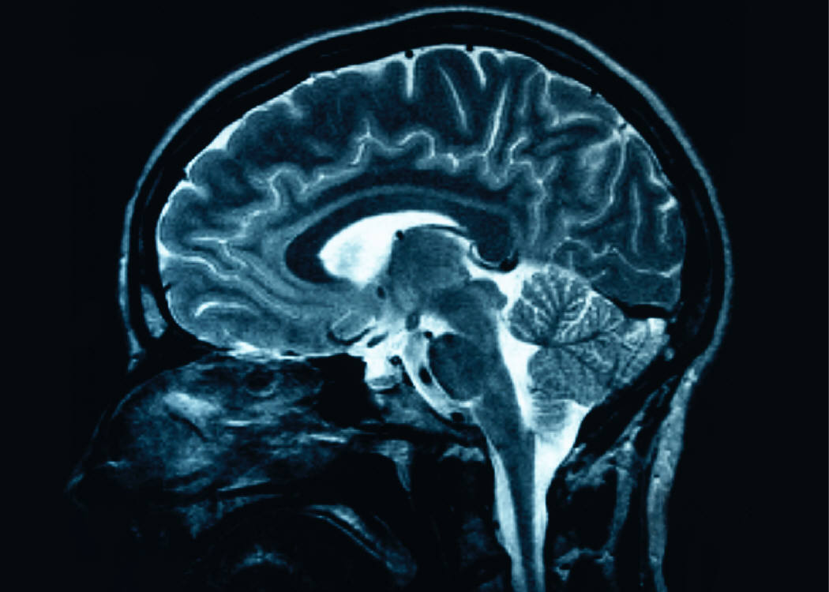
SUDs are chronic brain disorders
The brain shows distinct changes after substance use that can persist long after use has stopped
Notes:
26
TRAINER NOTES: The brain changes that occur as a result of ongoing drug use can be long lasting, and can persist long after the user has stopped using drugs. Studies show the brain can recover and return towards normal, but this recovery process takes time (exact time depends upon a number of factors).

Slide 27



PET Scan of Long-Term Meth Brain Damage
Notes:
TRAINER NOTES: Let’s revisit the monkey brain scans from earlier in the presentation. The researchers were going to stop the study at the 4-week mark. What would they have concluded from the study if they stopped then – that methamphetamine abusers’ brains are permanently damaged and do not recover?
But the researchers decided to track the monkeys over time to see if there were any further changes in the PET scans.
A repeated scan at six months post-meth still revealed little dopamine activity, suggesting that the damage done to the dopamine system persists for at least six months.
But PET scans at 1-year and 2-years post methamphetamine administration were conducted. The 1-year scan showed evidence of renewed dopamine activity (though not to the level at baseline), and by 2-years post meth administration, recovery of dopamine activity appeared to approach pre-methamphetamine administration levels.
These data strongly suggest that methamphetamine use can produce profound disruption to the dopamine system that lasts for at least six months, but does recovery over a 12- to 24-month period.

Slide 28

Substance Use and Mental Health
Self-medication for mental health problems
Impact substances have on brain and social functioning
Many MH disorders are rooted in same parts of brain, same neurotransmitters impacted by psychoactive substances
Common risk factors
  Genetics
  Environment (esp. trauma)
Notes:
TRAINER NOTES: This slide and the next slide highlight the way that substance use impacts mental health. When reviewing the slide, highlight that:
It is often unclear if substance use causes mental health problems, or if having mental health problems increases risk for substance use. In particular, people with mental health problems often self-medicate with psychoactive substances.
We know that substances impact brain and social functioning, so it could be that substance use causes mental distress in many cases. Research indicates that this may be the case because many mental health disorders are rooted in the same parts of the brain, and the same neurotransmitters, that are impacted by psychoactive substances.
IMAGE https://nccih.nih.gov/health/providers/digest/depression

Slide 29
Substance Use and Mental Health
43% of people with SUD have a co-occurring mental health disorder
Approx. 70% of people in SUD treatment have a co-occurring mental health disorder
MH DISORDER | SUD POPULATION | NON-SUD POPULATION
Depression | 28.51% | 2.74%
Anxiety | 16.87% | 2.22%
Major Psychoses | 6.56% | 0.38%
Weiss 1992, Robinson 2011, Martins 2011, SAMHSA 2010
Notes:
TRAINER NOTES: Review the slide, which highlights how rates of mental health disorders are very high among individuals with substance use disorders.

Slide 30
Substance Use and Physical Health
Behavioral risks
  More tobacco use: breathing problems/cancer
  Injections: collapsed veins, infections
  Intoxication leads to more risky sex behaviors
  Violence (pharmacological, systemic)
  Poverty
  Underutilization of healthcare services
Boles 2003, McCoy 2001, NIDA 2012b
Notes:
TRAINER NOTES: The next three slides highlight the connection between substance use and risk for physical health problems.
This slide lists the behavioral risks that are common among individuals who use psychoactive substances regularly that put their physical health at risk.
More information on the effects of substances on the body can be found at the National Institute on Drug Abuse website:
https://www.drugabuse.gov/publications/drugs-brains-behavior-science-addiction/preface

Slide 31
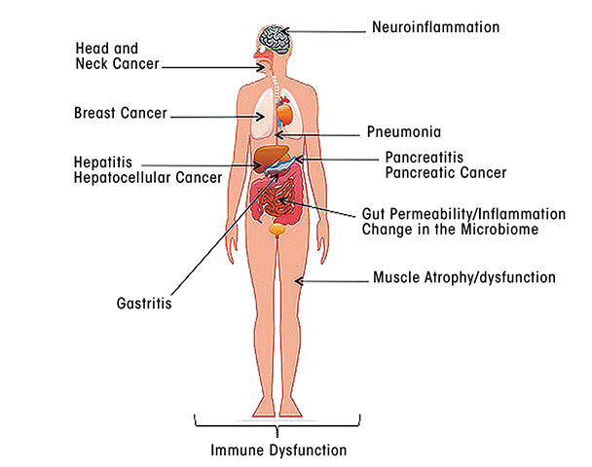
Substance Use and Physical Health
Direct medical consequences
  Effects on heart rate
  Decreases lung functioning
  Stomach inflammation
  Liver damage
  Kidney damage/failure
  Increased blood pressure/stroke
1/3 of people with SUD have a chronic physical condition or disease
NIDA 2012b, Reif 2011
Notes:
TRAINER NOTES: Summarize the slide, which provides an overview of the medical consequences of substance use.
IMAGE SOURCE: http://www.arcr.niaaa.nih.gov/arcr/arcr372/article01.htm

Slide 32

Substance Use Disorders Shorten Life
People who receive publicly-funded SUD services live 26.1 years less than the general population
Nearly 2/3 of excess death due to medical causes
Oregon Department of Human Services 2008
Notes:
TRAINER NOTES: The information on this slide was collected from a study conducted in Oregon, comparing the life expectancy of people who received publicly funded substance use disorder treatment with the rest of the population. The study found that the people who received SUD treatment died on average 26.1 years less than the general population. Notably, most of the premature death was not due to things we would expect like overdose, violence, or suicide; rather, it was due to medical causes. This underscores how negatively substance use can impact health—it can decrease life expectancy by over 25 years, and causes most premature mortality because of physical disease.

Slide 33

What does this mean for the people with whom you work?
Notes:
TRAINER NOTES: This is a transition to the next six slides, which focus on why it is particularly important to address substance use among adolescents.

Slide 34
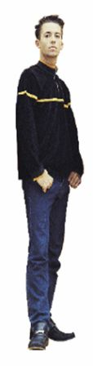


Most Substance Use Starts in the Teen/Young Adult Years
67%
26%
First Marijuana Use, (Percent of Initiates)
5.5%
1.5%
<12
12-17
18-25
>25
Notes:
TRAINER NOTES: Addiction is a developmental disease that usually begins in adolescence. For example, 67 percent of those who try marijuana for the first time are between the ages of 12 and 17. Prevention efforts are therefore of primary importance—to stop drug abuse before it ever starts.

Slide 35
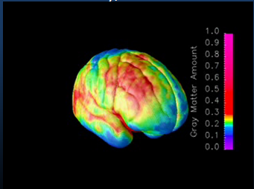
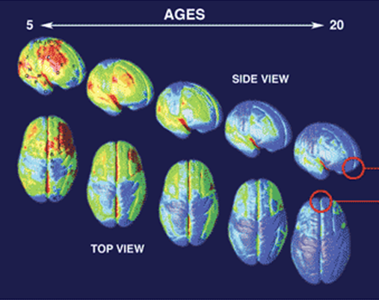
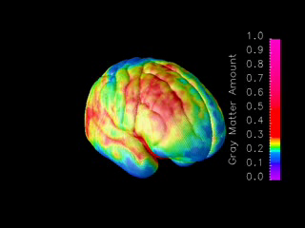
Brain Development
Ages 5-20 years
MRI scans of healthy children and teens compressing
15 years of brain development (ages 5–20).
Red indicates more gray matter, blue less gray matter.
Neural connections are pruned back-to-front.
The prefrontal cortex ("executive" functions), is last to mature.
Gogtay 2004; National Institute on Drug Abuse 2007.
35
Notes:
35
TRAINER NOTES: Constructed from MRI scans of healthy children and teens, this image compresses 15 years of brain development (ages 5–20) into just a few seconds. Red indicates more gray matter, blue less gray matter. Gray matter wanes in a back-to-front wave as the brain matures and neural connections are pruned. Areas performing more basic functions mature earlier; areas for higher order functions mature later. The prefrontal cortex, which handles reasoning and other "executive" functions, emerged late in evolution and is among the last to mature. Studies in twins are showing that development of such late-maturing areas is less influenced by heredity than areas that mature earlier.
**ANIMATION**
This slide has complex animations and the trainer should practice prior to training. A step-by-step guide is provided below.
This is a series of MRI scans from healthy children showing brain development as they age from 5 to 20 years.
Red indicates more gray matter and blue indicates less gray matter.
As you can see, the pruning occurs from the back of the brain toward the front.
This means that the prefrontal cortex (responsible for executive functioning, like decision-making) is the last to mature.
Point out that the animation is replaying so that people can see it again. A static image of the progression will appear on the lower left as well. When people have had time to observe, move forward to next slide.
35

Slide 36
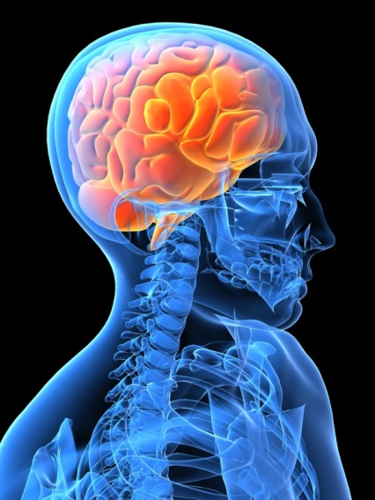
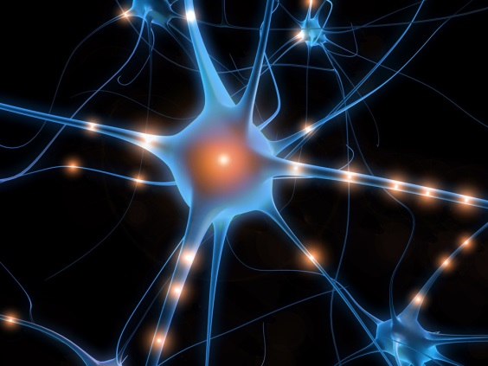
The Interaction between the Developing Nervous System and Substances of Abuse Leads to:
Difficulty in decision making
Difficulty understanding the
consequences of behavior
Increased vulnerability to
memory and attention problems
This can lead to:
Increased experimentation
Alcohol and drug addiction
36
Fiellin 2008.
Notes:
TRAINER NOTES: In reality, the exact impact of substance use on the developing brain is not known. However, when we look at the impact on the adult brain and understand normal development, several things seems true about this interaction, including that it may lead to difficulties in decision making and understanding the consequences of behavior (Fiellin, 2008). Additionally, it may increase the risk of memory and attention problems. These impairments, in turn, may lead to increased experimentation across a variety of behaviors; and increase the risk of addiction to a variety of substances (Fiellin, 2008).
Citation:
Fiellin, D.A. (2008). Treatment of adolescent opioid dependence: No quick fix. Journal of the American Medical Association, 300(17), 2057-2059.
36

Slide 37
Young Brains Are Different from Older Brains
Alcohol and drugs affect the brains of adolescents and young adults differently than they do adult brains
  Adolescent rats are more sensitive to the memory and learning problems than adults
  Conversely, they are less susceptible to intoxication (motor impairment and sedation) from alcohol
These factors may lead to higher rates of dependence in these groups
37
Hiller-Sturmhöfel 2004
Notes:
37
TRAINER NOTES: The brain continues to develop into adulthood and undergoes dramatic changes during adolescence. This means that young brains are different from older brains. One example of this difference is evidenced by the fact that adolescent rats are: more susceptible to the effects of alcohol on memory and learning, but less susceptible to the motor and sedative effects.
These factors may combine to increase the vulnerability to substance dependence in adolescents and young adults.
Citation:
Hiller-Sturmhofel, S., & Swartzwelder, H.S. (2004/2005). Alcohol’s effects on the adolescent brain: What can be learned from animal models. Alcohol Research & Health, 28(4), 213-221.
37

Slide 38

Later Onset Substance Use and SUD Risk
Early onset substance use predicts development of SUD
The later adolescents start using, the less likely they are to develop SUD
  Alcohol: During adolescence, odds of dependence decrease 14% for every year of delayed first use
  Drugs: Odds of dependence decrease 4-5% for every year of delayed first use
Grant 1997, 1998
Notes:
TRAINER NOTES: Read the information on the slide, highlighting that because young brains are still developing and more vulnerable to the effects of substances, people who use substances at a younger age are at risk for dependence. Thus it is critically important to prevent or limit substance use during adolescence.

Slide 39
We Can’t Treat Our Way Out of This Public Health Crisis
Approx. 21.5 million Americans have SUD
Traditionally we wait for people to get sick, then treat them
Only 11% of people with SUD get specialty care
  Only 5% of adolescents
Early detection and prevention are public health strategies to address SUD
Given the key role of adolescence in the development of SUD, people who work with adolescents can be the front line in preventing SUD
Center for Behavioral Health Statistics and Quality 2015
Notes:
TRAINER NOTES: This slide has animations – practice it before presenting.
This slide highlights how by addressing substance use in adolescence, we can have a significant impact on the current public health crisis related to SUD that the country is facing. Only 11% of people with SUD get specialty care, and the specialty treatment system is not equipped to address demand for SUD services. Through prevention, we can help close the gap between SUD treatment need and SUD treatment capacity. Given the key role adolescence plays in the development of SUD, focusing prevention and early intervention efforts on adolescents can have a significant impact by preventing the development of SUD in the future.

Slide 40

Why Do Prevention and Early Intervention in Juvenile Justice Settings?
Studies show that 25-67% of juvenile offenders meet diagnostic criteria for SUD
Substance use among juvenile offenders associated with other problems
  Sexual risk behaviors
  Violence and accidents
  Less positive educational, occupational, psychological outcomes
Strongly associated with recidivism among adolescents
Encounter with justice system a potential “teachable moment”
Chassin 2008, Stoolmiller 2005, Benner 2010; Substance Abuse and Mental Health Services Administration 2016
Notes:
TRAINER NOTES: Highlight that juvenile justice providers are well-suited to address substance use among adolescents because many of the adolescents they serve have serious issues related to substance use, as described on the slide. Also highlight that it is in the interest of juvenile justice providers to address substance use since it is strongly associated with recidivism.
IMAGE http://juvenilecourt.nashville.gov/
Citation:
National Institute on Drug Abuse. (2016). Monitoring the Future 2015: Teen Drug Use. https://www.drugabuse.gov/related-topics/trends-statistics/infographics/monitoring-future-2015-survey-results. Accessed April 11, 2016.
CHC
1Weinstein. (2006). School-based health centers and the primary care physician: An opportunity for collaborative care. Primary Care, 33, 305-315.

Slide 41
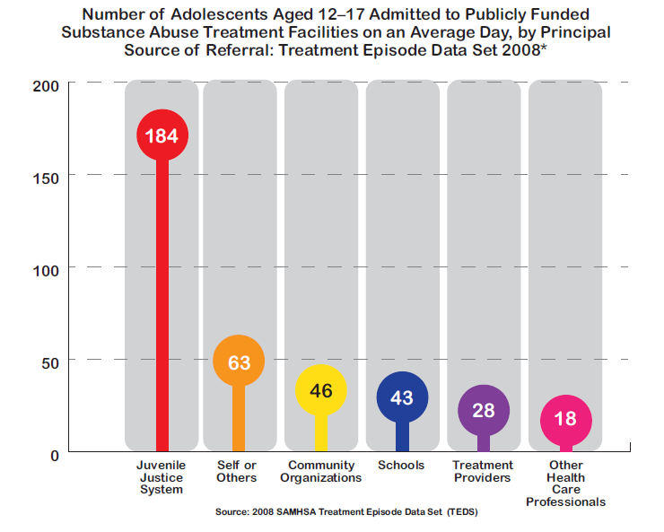
The Juvenile Justice System is Good At Getting Adolescents into Treatment!
This is notable because most other providers have a lot of trouble with this!
Notes:
TRAINER NOTES: This slide shows that compared to other institutions, juvenile justice providers are effective at referring adolescents to treatment. This is likely because they can compel them to attend (instead of just recommending it). Consequently, it is essential for juvenile justice providers to develop knowledge of how to identify adolescents who are at risk because of substance use, and engage in the process of linking them to specialty services if needed.

Slide 42
SBIRT:
A Population Approach to Prevention/Early Intervention
Screening a population to identify individuals who are using substances in a risky or unhealthy way
Brief Intervention to change behaviors and attitudes of individuals who are putting their health at risk with substance use.
  Sometimes this is one intervention, sometimes a few sessions
Referral to Treatment for individuals who require specialty care (behavioral, pharmacological treatments)
Notes:
TRAINER NOTES: This slide and the next slide present SBIRT, describing what it is and what it can accomplish.

Slide 43
What SBIRT Can Accomplish
Identify adolescents with SUD and link them with specialty care (about 5% of adolescents)
Severe
Mild
None
Substantial
Moderate
Educate adolescents who are using substances (approx 11.5% using alcohol, 9.4% using drugs) motivate behavior change)
Notes:
TRAINER NOTES: The statistic that 5% of adolescents screened will have an SUD comes from the 2013 National Survey on Drug Use and Health: Summary of National Findings http://www.samhsa.gov/data/sites/default/files/NSDUHresultsPDFWHTML2013/Web/NSDUHresults2013.htm#7.3

Slide 44
Take Away Points
Adolescents are vulnerable to impacts of psychoactive substances
Prevention and early intervention for SUD is about more than just substance use
  Reducing risky behaviors and consequences
  Reducing mental health and physical problems associated with substance use
Decreasing substance use in adolescence can decrease prevalence of SUD in entire US population
4. Juvenile justice providers are in prime position to deliver prevention and early intervention services to high risk youth, and help address the public health crisis of substance use
5. The SBIRT model can be used to identify adolescents who are using substances in a risky manner and facilitate positive change.

Slide 45

Questions? Comments?

Slide 46
WORKS CITED
Benner, G. J., Stage, S. A., Nelson, J. R., Laederich, M., & Ralston, N. C. (2010). Predicting the cumulative recidivism of juvenile detainees. The Journal of Behavior Analysis of Offender and Victim Treatment and Prevention, 2(1), 51-62
Boles, S. M., & Miotto, K. (2003). Substance abuse and violence: A review of the literature. Aggression and violent behavior, 8(2), 155-174.
Boone MR, Cook SH, Wilson P. (2013). Substance use and sexual risk behavior in HIV-positive men who have sex with men: an episode-level analysis. AIDS Behavior 17L1883-1887.
Bureau of Justice Statistics (ND). Drugs and Crime Facts. http://www.bjs.gov/content/dcf/duc.cfm#to Accessed December 10, 2016.
Center for Behavioral Health Statistics and Quality (2015). Behavioral Health Trends in the United States: Results from the 2014 National Survey on Drug Use and Health. (HHS Publication No. SMA 15-4927, NSSDUH Series H-50).
Chassin, L. (2008). Juvenile justice and substance use. The Future of Children, 18(2), 165-183.
Cherpitel CJ. (2007) . Alcohol and injuries: a review of international emergency room studies since 1995. Drug and Alcohol Review 26:208-214.
DiChiara G, Bassareo V. (2007) Reward system and addiction: what dopamine does and does not do. Current Opinions in Pharmacology 7(1):69-76.
DiChiara G., Imperato A., Mulas A. (1987). Preferential stimulation of dopamine release in the mesolimbic system: a common feature of drugs of abuse. In Sanlder M, Feurstein C, Scatton B (eds). Neurotransmitter interactiosn in the basal ganglia. New York: Raven Press, p. 171-182.
D’Onofrio G et al. (2008). Brief intervention for hazardous and harrmful drinkers in the emergency department. Annals of Emergency medicine 51(6): 742-750.
Fiellin, D. A. (2008). Treatment of adolescent opioid dependence: no quick fix. JAMA, 300(17), 2057-2059.
Fiorino DF, Phillips AG. (1999). Facilitation of sexual behavior and enhanced dopamine effluc in the nucleus accumbens of male rats after D-amphetamine-induced behavioral sensitization. Journal of Neuroscience 19(1): 456-463.
Flynn, P. M., & Brown, B. S. (2008). Co-occurring disorders in substance abuse treatment: Issues and prospects. Journal of substance abuse treatment, 34(1), 36-47.
Gogtay, N., et. al. (2004). Dynamic mapping of human cortical development during childhood through early adulthood. Proceedings of the National Academy of Sciences, 101, 8174-8179.
Grant, B. F., & Dawson, D. A. (1997). Age at onset of alcohol use and its association with DSM-IV alcohol abuse and dependence: results from the National Longitudinal Alcohol Epidemiologic Survey. Journal of substance abuse, 9, 103-110.
Grant, B. F., & Dawson, D. A. (1998). Age of onset of drug use and its association with DSM-IV drug abuse and dependence: results from the National Longitudinal Alcohol Epidemiologic Survey. Journal of substance abuse, 10(2), 163-173.
Hiller-Sturmhofel, S., & Swartzwelder, H. S. (2004). Alcohol's effects on the adolescent brain: what can be learned from animal models. Alcohol Research and Health, 28(4), 213.
Martins, S. S., & Gorelick, D. A. (2011). Conditional substance abuse and dependence by diagnosis of mood or anxiety disorder or schizophrenia in the US population. Drug and alcohol dependence, 119(1), 28-36.
McCoy, C. B., Metsch, L. R., Chitwood, D. D., & Miles, C. (2001). Drug use and barriers to use of health care services. Substance use & misuse, 36(6-7), 789-804.
McDonald AJ, Wang N, Camargo CA. (2004). US emergency department visits for alcohol-related diseases and injuries between 1992 and 2000. Archives of Internal Medicine . 164:531-537.

Slide 47
WORKS CITED
Mertens, J. R., Lu, Y. W., Parthasarathy, S., Moore, C., & Weisner, C. M. (2003). Medical and psychiatric conditions of alcohol and drug treatment patients in an HMO: comparison with matched controls. Archives of Internal Medicine, 163(20), 2511-2517.
Naimi, T. S., Lipscomb, L. E., Brewer, R. D., & Gilbert, B. C. (2003). Binge drinking in the preconception period and the risk of unintended pregnancy: implications for women and their children. Pediatrics, 111(Supplement 1), 1136-1141.
National Institute on Alcohol Abuse and Alcoholism (2004). Alcohol’s Damaging Effects on the Brain. Alcohol Alert 63. http://pubs.niaaa.nih.gov/publications/aa63/aa63.htm Accessed January 10, 2017.
NIDA. (2007). Drugs Brains, and Behavior: The Science of Addiction (NIH Pub No. 07-5605). Downloaded from http://www.drugabuse.gov/ScienceofAddiction.
National Institute on Drug Abuse (2012) What are Co-Occurring Disorders? https://teens.drugabuse.gov/blog/post/what-are-co-occurring-disorders. Accessed July 22, 2016.
National Institute on Drug Abuse (2012b) Medical Consequences of Drug Abuse https://www.drugabuse.gov/related-topics/medical-consequences-drug-abuse. Accessed January 22, 2016.
National Institute on Drug Abuse (2016) Brain dopamine release reduced in severe marijuana dependence. https://www.drugabuse.gov/news-events/news-releases/2016/03/brain-dopamine-release-reduced-in-severe-marijuana-dependence accessed January 10, 2017.
National Highway Traffic Safety Administration (ND). Drug and alcohol crash risk study available http://www.nhtsa.gov/Driving+Safety/Research+&+Evaluation/Alcohol+and+Drug+Use+By+Drivers Accessed December 10, 2016.
Oregon Department of Human Services, Addiction and Mental Health Division (2008) Measuring Premature Mortality Among Oregonians.
Reif, S., Larson, M., Cheng, D. M., Allensworth-Davies, D., Samet, J., & Saitz, R. (2011). Chronic disease and recent addiction treatment utilization among alcohol and drug dependent adults. Substance abuse treatment, prevention, and policy, 6(1), 1.
Robinson, J., Sareen, J., Cox, B. J., & Bolton, J. M. (2011). Role of self-medication in the development of comorbid anxiety and substance use disorders: a longitudinal investigation. Archives of General Psychiatry, 68(8), 800-807.
Shoblock, J. R., Sullivan, E. B., Maisonneuve, I. M., & Glick, S. D. (2003). Neurochemical and behavioral differences between d-methamphetamine and d-amphetamine in rats. Psychopharmacology, 165(4), 359-369.
Smith PH, Homish GO, Leonaard KE, Cornelius JR. (2012). Intimate Partner Violence and Substance Use Disorders: Findings from the National Epidemiological Survey on Alcohol and Related Conditions. Psychology of Addictive Behaviors 26(2): 236-245.
Stoolmiller, M., & Blechman, E. A. (2005). Substance use is a robust predictor of adolescent recidivism. Criminal justice and behavior, 32(3), 302-328.
Substance Abuse and Mental Health Services Administration (2010) Integrated Treatment for Co-Occurring Disorders Evidence-Based Practices (EBP) Available at http://store.samhsa.gov/product/Integrated-Treatment-for-Co-Occurring-Disorders-Evidence-Based-Practices-EBP-KIT/SMA08-4367
Substance Abuse and Mental Health Services Administration (2016). Criminal and Juvenile Justice. http://www.samhsa.gov/criminal-juvenile-justice
Upadhyay, J., Maleki, N., Potter, J., Elman, I., Rudrauf, D., Knudsen, J., ... & Anderson, J. (2010). Alterations in brain structure and functional connectivity in prescription opioid-dependent patients. Brain, 133(7), 2098-2114.
Vitale S, van de Mheen D. (2006). Illicit drug use and injuries: A review of emergency room studies. Drug and Alcohol Dependence 82 1-9.
Weiss, R. D., Mirin, S. M., & Griffin, M. L. (1992). Methodological considerations in the diagnosis of coexisting psychiatric disorders in substance abusers. British Journal of Addiction, 87(2), 179-187.

