Slide 1
SBIRT Integration into SBHC Workflow
Section 8
Notes:
Laura’s section

Slide 2
Incorporate SBIRT for alcohol, substance use, and depression into SBHC workflow
Screening Questionnaire
PCP
Visits
Administration Which Visits Brief Interventions
Scoring Assessment, Brief Advice, Further Assessment
Documentation Brief Interventions Teen Intervene
Coding Coding Coding
Linkage Agreements for Treatment
BHP Visits and Referrals
Notes:
Considerations:
Questionnaire
paper, in electronic medical record, scanned into electronic medical record
self-administered paper and pen or on computer
Support staff or provider administered paper and pen or on computer
Who will administer the questionnaire? Who will score the questionnaire? (receptionist, medical assistant, nurse, PCP, BHP)
How will it be documented in health record?
How will it be coded?
PCP Visits
Well child, referrals from school for alternatives to suspension, E and M visits
Who will do assessments and brief advice / interventions? (PCP, BHP)
How will they be coded?
BHP Visits and Referrals
Will they do brief interventions? When?
When will they conduct further assessment and diagnostic interview?
How will they conduct Teen Intervene Sessions? (individual, group, both, 45 or 90 minute sessions?
How will they code these visits?
With which treatment resource(s) will SBHC have a linkage agreement(s), Who will be the main contact at each facility? Who will initiate the referral?
Policies and Procedures
Needed to describe each scenario?

Slide 3

Keys to sustainable clinic workflow
  Secure buy-in from clinic leadership
  Policies and procedures
  Train providers and staff
  Identify clinic champions
  Employ clinic tools
  Optimize EMR

Slide 4
Confidentiality
Section 8

Slide 5
Confidentiality
In substance abuse field, confidentiality is governed by federal law (42 U.S.C. § 290dd-2) and regulations (42 CFR Part 2)
42 CFR Part 2 applies to any program that:
  1) involves substance abuse education, treatment, or prevention 2) is regulated or assisted by the federal government
  Law outlines under what limited circumstances information about client’s treatment may be disclosed with and without client’s consent.
Notes:
Determining when 42 CFR Part 2 is applicable and how to legally access information about substance abuse treatment requires practitioners to work through a series of questions.
Protecting confidentiality is critical in substance abuse treatment and child welfare. Both fields need to guard clients’ rights to privacy and protect against the stigma that might cause clients to avoid treatment. Yet while monitoring cases, child welfare professionals regularly need information related to diagnosis and participation in treatment. Child welfare practitioners should be familiar with the rules and regulations that govern confidentiality and the legal methods of accessing otherwise protected information.
What Information Is Protected?
42 CFR Part 2 applies to all records relating to the identity, diagnosis, prognosis, or treatment of any patient in a substance abuse program that is conducted, regulated, or directly or indirectly assisted by any department or agency of the United States.
How Can Protected Information Be Shared?
Information can be shared if written consent is obtained. A written consent form requires ten elements (42 C.F.R. § 2.31(a); 45 C.F.R. § 164.508(c)):
1. the names or general designations of the programs making the disclosure
2. the name of the individual or organization that will receive the disclosure
3. the name of the patient who is the subject of the disclosure
4. the specific purpose or need for the disclosure
5. a description of how much and what kind of information will be disclosed
6. the patient’s right to revoke the consent in writing and the exceptions to the right to revoke or, if the exceptions are included in the program’s notice, a reference to the notice
7. the program’s ability to condition treatment, payment, enrollment, or eligibility of benefits on the patient agreeing to sign the consent, by stating
1) the program may not condition these services on the patient signing the consent, or 2) the consequences for the patient refusing to sign the consent
8. the date, event, or condition upon which the consent expires if not previously revoked
9. the signature of the patient (and/or other authorized person)
10. the date on which the consent is assigned
When used in the criminal-justice setting, expiration of the consent may be conditioned upon the completion of, or termination from, a program instead of a date.

Slide 6

Recommended Confidentiality
Establish confidentiality policy and procedure
Post confidentiality policy in SBHC
Communicate to student and parent /guardian that privacy is needed to complete the screen
Interview adolescent without parents present

Slide 7
Recommended Confidentiality
Information can remain confidential unless safety is at risk.
Check state law for guidelines regarding when confidentiality must be broken.
When confidentiality must be broken, discuss first.
Try out words to use, avoid revealing small details unless absolutely necessary.

Slide 8

HIPAA
Health Insurance Portability and Accountability Act of 1996, Public Law 104-191
Privacy rule that protects all “individually identifiable health information” held or transmitted by a covered entity or its business associate, in any form or media, whether electronic, paper, or oral
Notes:
Health care providers who electronically transmit health information in connection with certain transactions are covered entities.
Schools could be covered entities if billing Medicaid for Medicaid covered services in the school setting.
Things to consider:
Establish confidentiality policy
Establish standard routine to screen universally
Communicate to patient and parent that privacy is needed to complete the screen.
Things to consider:
Review your confidentiality policy with parents.
Discuss benefits of maintaining confidentiality vs. risks of breaking confidentiality.
Assure parents their teen has been screened and no further assessment is recommended at this time.

Slide 9
FERPA
Family Educational Rights and
Privacy Act
Enacted in 1974 to protect
student education records
Applies to all public and private schools that accept federal funds
Records directly related to a student and maintained by an educational agency
Student health records at the elementary and secondary level (immunization record, physical exam, health screening results, etc.)
Special Education records

Slide 10
When HIPAA and FERPA Collide
HIPAA SBHC able to share health information with school nurse in the treatment of a patient/student,
FERPA the school nurse not be able to provide information SBHC or other health care provider with out a consent /authorization form signed by a parent / guardian
Notes:
Discuss other scenarios
Do you know of any changes in the confidentiality laws?

Slide 11
SBHC Integration
Objective: Describe collaborative approaches for integrating substance abuse screening, assessment, and interventions into the school-based setting.
Section 10
Notes:
Iliana ’s Section
Now we are going to discuss SBHC integration into the school environment. If you are going to successfully implement programs in your SBHC, it is so important that the school is on board and supportive.
Ask audience—how do you perceive adequate or successful integration? How do you evaluate how integrated your SBHC is within the school fabric? Do most students know where to find you? Do most teachers recognize or know who are the clinic staff members? What about the school secretary? The janitors? The cafeteria crew?
Within the SBIRT initiative, you won’t be able to successfully operate the components of SBIRT if you remain a silo.
We at the SBHA have 6 principles to successful SBHC integration. We are going to go through each of the principles now.

Slide 12

Principles of Integration
Implement mutually supportive policies that support student health and academic achievement.
Notes:
Shared accountability, shared outcomes
As educational attainment increases, health inequities decrease.
In a fragmented school environment, the SBHC is not aware of the education-related policies that govern administrators and instructors; conversely, school staff aren’t aware of what guidelines govern the staff within the SBHCs, their licensures, and their scope of practice. A strong partnership allows the SBHC and school staff to communicate regaulary about the policies that direct and drive their respective work, and where students’ needs intersect.

Slide 13

Principles of Integration
Implement school wide strategies and frameworks that support health and academics and help at-risk students
“the knee bone is connected to the leg bone”
Notes:
In weaker environments, the SBHC is rarely thought of as a partner or consultative resource when new or enhanced school-wide initiatives are planned or implemented. When an SBHC is well integrated, they the SBHC is routinely part of the conversation and planning process. Strategies to support health,
behavior and academics for at risk students are most often considered one and the same.

Slide 14
Principles of Integration
Implement collaborative leadership systems and structures to plan programs and direct resources to at-risk students and their families.
Notes:
Emerging integrative environments may yield a setting where SBHC staff and school faculty members/administration rarely convene or interact in shared activities or priorities. Stronger environments demonstrate how school administration and leaders advocate
for health providers and programs, and health partners
advocate on behalf of the school and programs not traditionally viewed as health-related.

Slide 15

Principles of Integration
Implement integrated school - health programs and services that support school goals and target student populations of concern.
Notes:
Weak or emerging settings—health partners develop health programs and the
school administration and staff develops academic programs.
Stronger examples—health programming and interventions are well integrated
into the classroom and school events/programs.

Slide 16
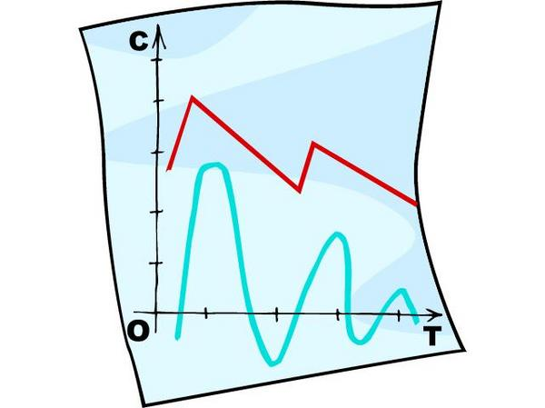
Principles of Integration
Utilize education and health data to drive continuous quality improvement that informs policy and program development.
Notes:
Weak or emerging environments—data b/w SBHC and school staff are rarely exchanged with one another.
Strong environments--- Needs assessment is conducted at least annually in collaboration with school administrators, staff, and health partners. Data is used regularly to
develop programming and evaluate program quality and effectiveness in meeting identified needs.

Slide 17

Principles of Integration
6. Engage in joint resource development (e.g. fundraising, business partnerships, professional development) to support priority programs and services.
Notes:
Emerging—school partners have no idea how SBHC activities are financed, funded, reimbursed, billed, etc.
Strong examples—health partners and school administrators/ staff often collaborate on grants or have conversations about how to leverage funding and resources to support jointly developed
priorities. School and health partners view each other as key resource development partners, especially in tough economic times.

Slide 18
Mapping SBHC Integration
Principles
(Broad Component of Integration)
Structures
(Policy or System Designed to Achieve Principle)
Processes
(How Structure is Implemented)
Anticipated Outcomes
(Specific Outcomes for Students & Families)
Notes:
SBHC Integration has several key characteristics. You have the broad principles that we just reviewed, but within those principles are the infrastructures and processes that help drive the outcomes for student success.

Slide 19
Integration Activity
School Health Integration Worksheet
Notes:
Within your SBHC, please complete the school health integration worksheet. Have all groups pull out integration worksheet from folders. They will fill out the worksheet based on what they think their SBHC needs. If they need help we will have several ideas on papers in the middle of the tables.
http://ww2.nasbhc.org/infographic/resources/Integration%20Rubric.pdf
http://ww2.nasbhc.org/infographic/resources/Integration-Self-Assessment.pdf

Slide 20
Improvement Plans & PDSA Cycles

Slide 21

Quick Review of Learning Collaboratives

Slide 22
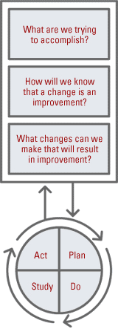
Collaboratives according to the Institute for Healthcare Improvement
Quality improvement model that is focused on created rapid changes and processes
Uses Plan-Do-Study-Act cycle as main mechanism
Addresses 3 main questions

Slide 23
SBHC Collaboratives
Preventive Services Improvement Initiative (PSII)
Mental Health Education and Training (MHET)
Hallways to Health (current)
SBIRT in SBHCs (current)
Notes:
Laura provides historical context behind SBHA collaboratives and national significance.
After the training we will send you a pdf describing previous collaboratives in detail. Show the document.
Iliana describes two of current learning collaboratives

Slide 24
Improvement Plans: 7 steps towards success

Slide 25
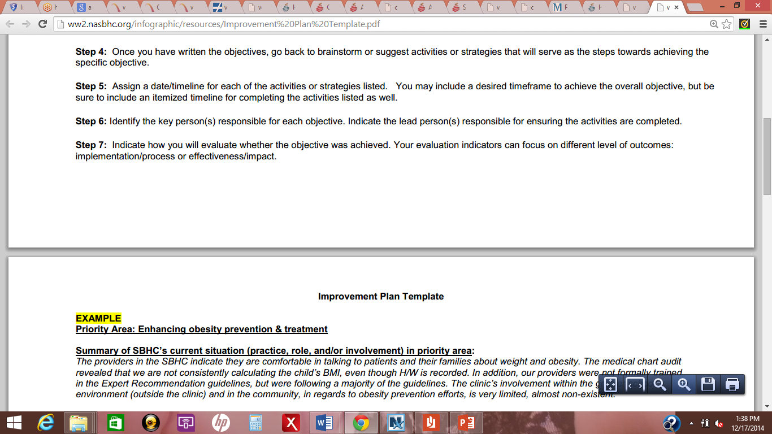
Step 1
Using the information collected from the SBHC assessment or S.W.O.T. analysis, select the priority area(s) to direct the focus of the improvement process.
Identify which areas of your current practices or situation needs attention.

Slide 26
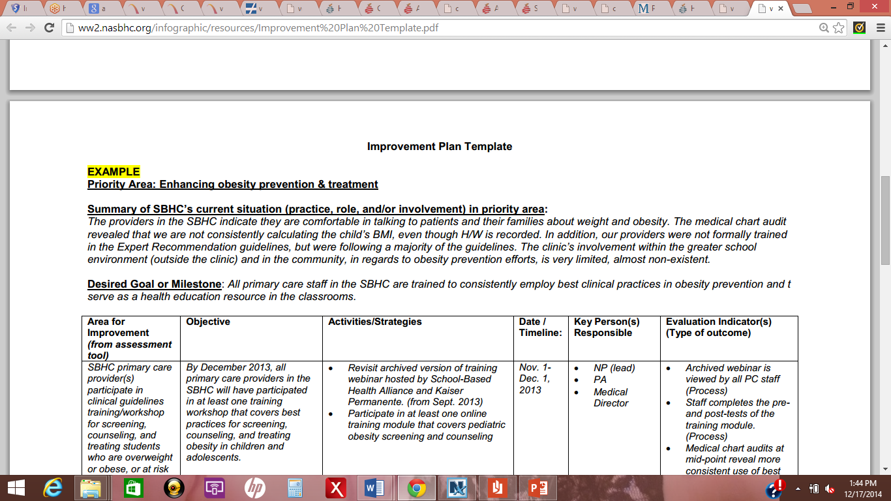
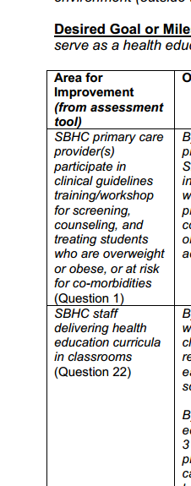
Step 2
Provide a brief summary of the clinic’s current practice, role, and/or involvement for each of your selected priority areas.
Summarize what is the “area of improvement” you are focusing on—it can be paraphrased from a question item on the particular assessment tool used or the SWOT analysis exercise.

Slide 27
Step 3
Write a SMART objective that will aim to improve the current situation. Do this for all priority area(s) before developing activities and strategies.

Slide 28
Objectives should be…
Specific
Measurable
Achievable
Realistic
Time
To obtain funding necessary to sustain the school-based health center by April 10, 2015.
To develop the infrastructure for a school-based health center in Smart Elementary School by May 15, 2014.

Slide 29

Step 4
Once you have written the objectives, go back to brainstorm or suggest activities or strategies that will serve as the steps towards achieving the specific objective.

Slide 30

Step 5
Assign a date/timeline for each of the activities or strategies listed.
You may include a desired timeframe to achieve the overall objective, BUT be sure to include an itemized timeline for completing the activities listed as well.

Slide 31

Step 6
Identify the key person(s) responsible for each objective. Indicate the lead person(s) responsible for ensuring the activities are completed.

Slide 32
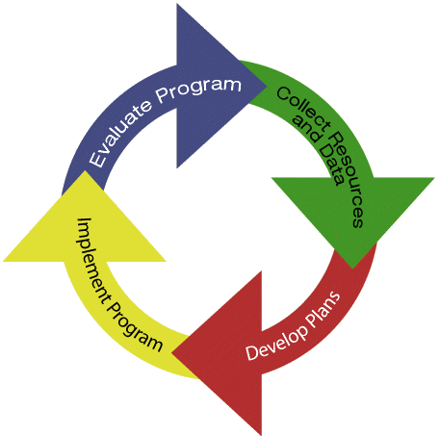
Step 7
Indicate how you will evaluate whether the objective was achieved.
Your evaluation indicators can focus on different level of outcomes:
    implementation/process
    effectiveness/impact

Slide 33
PDSA Cycles: Examples & Simulation

Slide 34
Plan, Do, Study Act (PDSA) Cycle
Act
Determine what modifications should be made.
Plan
State objective.
Do
Carry out the test.
Study
Complete data analysis.
Make predictions about what will happen and why.
Develop a plan to test the change. (What data need to be collected?)
Document problems and unexpected observations.
Begin data analysis
Compare the data to your predictions.
Summarize & reflect on what was learned.
Prepare a plan for the next test.
Notes:
Who is familiar with the PDSA cycle
Plan Do Study Act – continuous cycle of improvement
Read slide
Compare to: identify goal (Plan)
identify measure (Do)
identify change (Study and Act)
Objective: Review PDSA Cycle
Explanation: The Plan-Do-Study-Act (PDSA) cycle is shorthand for testing a change in the real work setting — by planning it, trying it, observing the results, and acting on what is learned. This is the scientific method used for action-oriented learning. The steps of the PDSA cycles are:
Step 1: Plan
Plan the test or observation, including a plan for collecting data. State the objective of the test. Make predictions about what will happen and why. Develop a plan to test the change. (Who? What? When? Where? What data need to be collected?)
Step 2: Do
Try it out the test on a small scale. Carry out the test. Document problems and unexpected observations. Begin analysis of the data.
Step 3: Study
Set aside time to analyze the data and study the results. Complete the analysis of the data. Compare the data to your predictions. Summarize and reflect on what was learned.
Step 4: Act
Refine the change, based on what was learned from the test. Determine what modifications should be made. Prepare a plan for the next test.
Depending on their aim, teams choose promising changes and use Plan-Do-Study-Act (PDSA) cycles to test a change quickly on a small scale, see how it works, and refine the change as necessary before implementing it on a broader scale. The following example shows how a team started with a small-scale test.
Planned visits for HIV medication education and management:
Plan: Ask one patient if he or she would like to participate in a planned visit to learn with others more about medication and side effects Do: Dr. J. asked his first patient with HIV on Tuesday. Study: Patient was interested; Dr. J. was pleased at the positive response. Act: Dr. J. will continue with the next five patients and set up a planned visit for those who say yes.
Bridge to next slide: Testing changes however, is an iterative process: the completion of each Plan-Do-Study-Act (PDSA) cycle leads directly into the start of the next cycle.

Slide 35
Repeated use of PDSA cycle
Changes
that result in
Improvement
A P
S D
DATA
D S
P A
A P
S D
A P
S D
Hunches,
Theories,
Ideas

Slide 36
Start Small and Do More
Improved Decision Support
D
S
DATA
P
A
A
P
S
D
Cycle 1E: Implement and
monitor the standards
D
S
P
A
Cycle 1D: Revise and test flow-
sheet with all patients for one week
A
S
P
Use of flowsheet will improve care to known standards
D
Cycle 1C: Present refined flowsheet to all 3 clinicians and document feedback
A
P
S
D
Cycle 1B: Revise flowsheet and test with Dr. Burton’s patients next Monday
Cycle 1A: Adapt Clinic X Standard’s based flow sheet and test with one of Joanne’s patients
Notes:
Objective: Start small and do more
Explanation: Our advice is to start small and do more. For example: The Aim of this project is to improve decision support. The theory or hunch (or belief) is that use of a standards based flow sheet will improve care to known standards. Follow the cycle tests up the ramp.
Bridge to next slide: We have some other advice (or tips) for you regarding the PDSA cycle.

Slide 37
Use objective(s) to drive PDSA cycles
Break down large objectives into manageable cycles to implement changes for improvement
Some objectives can be broken down into one or two cycles
Others may need more, depending on the complexity of what is to be achieved
Cycles should be brief in nature

Slide 38
Plan-Do-Study-Act Example:
Improving Attendance
OVERALL PLAN: Improve student attendance
  Objective for this cycle: Establish process for assessing SBHC clients’ attendance
  Questions you may consider to help you achieve this objective:
Notes:
Let’s walk through an example. Say you are part of a larger movement at the school to improve attendance rates.

Slide 39
Plan-Do-Study-Act Example:
Improving Attendance
OVERALL PLAN: Improve student attendance
  Theory of change (by doing “X” will we achieve our objective?):
  Plan for change:
    What
    Who
    When

Slide 40
Plan-Do-Study-Act Example:
Improving Attendance
OVERALL PLAN: Improve student attendance
  How will we demonstrate the effectiveness of our actions?

Slide 41
Plan-Do-Study-Act Example:
Improving Attendance
DO:
Carry out the plan for change. Collect information and/or data.
Describe observations, problems encountered, and special circumstances:

Slide 42
Plan-Do-Study-Act Example:
Improving Attendance
STUDY:
Analyze effectiveness of plan and summarize what was learned.

Slide 43
Plan-Do-Study-Act Example:
Improving Attendance
ACT…
Plan for the next cycle:
  How shall we modify our existing plan, or shall we start a new one?

Slide 44

Improvement Plans for SBIRT
L
Notes:
Good news---the improvement plan has mostly been filled out for you.

